Slide 1

Quantitative Methods in Finance
L1, L2 Filter and Momentum Strategies
——Applying to S&P 500 Index
Yuxiao Cheng
Ruocheng Zhang
Jinyang Li
Dec. 12th 2019

Slide 2
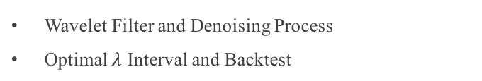

Structure of Research
L2 Filter, L1-T Filter, L1-C Filter, L1-TC Filter
Computational Aspects : Scheme and Solution
Trend Filtering Approaches
2 Models of Stochastic Process for Simulation
Trend of Simulated Data Using 4 Filters
Simulation and Filter Comparation
Cross Validation Method and Optimal $λ$
Trend filter on S&P 500 with Optimal $λ$
Cross Validation
Trend Detection Method and Implementation
Distribution of the Conditional Standardized Return
Trend Detection and Distribution
Backtest Assumptions and Procedures on S&P 500
Momentum Strategy and Results on S&P 500
Momentum Strategies and Backtest
Wavelet Filter and Denoising Process
Optimal $λ$ Interval and Backtest
Challenges and Improvements

Slide 3

Quantitative Methods in Finance
1. Trend Filtering Approaches
L2 Filter
L1-T Filter
L1-C Filter
L1-TC Filter

Slide 4
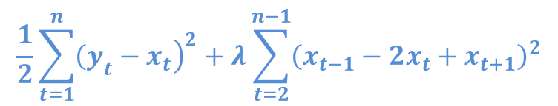


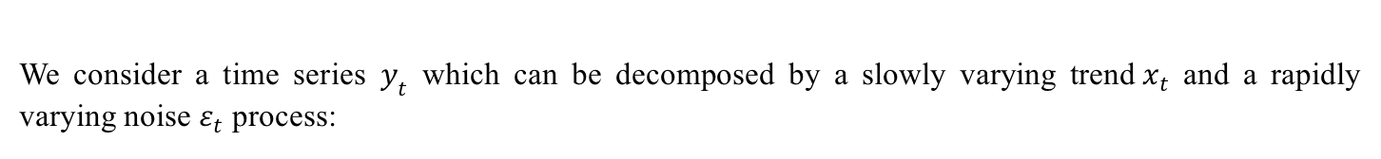
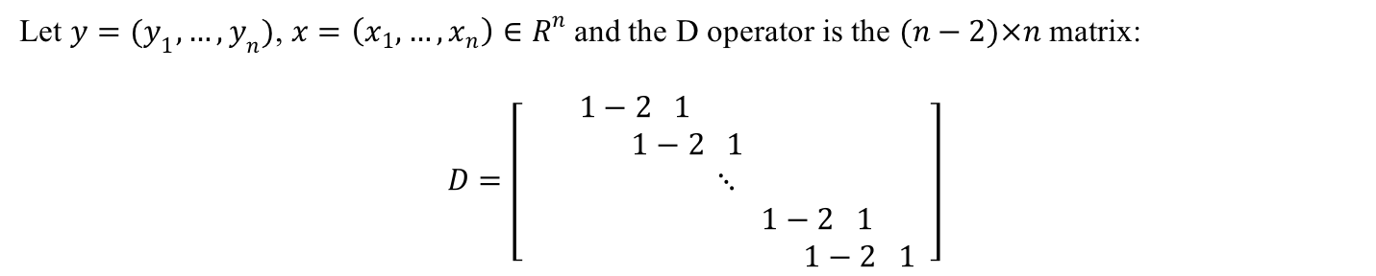
The L2 Filter
We consider a time series $y_{t}$ which can be decomposed by a slowly varying trend$x_{t}$ and a rapidly varying noise $ε_{t}$ process:
$$y_{t}=x_{t}+ε_{t}$$
In L2 filter, the scheme consists to determine the trend $Xt$ by minimizing the following function:
$$\frac{1}{2}\sum_{t=1}^{n}{{\left.{\left(y\right.}_{t}−x_{t}\right)}^{2}}+λ\sum_{t=2}^{n−1}{{\left(x_{t−1}−2x_{t}+x_{t+1}\right)}^{2}}$$
Let $y=(y_{1},…,y_{n})$, $x=\left(x_{1},…,x_{n}\right)∈R^{n}$ and the D operator is the $(n−2)×n$ matrix:
$$D=\left[\begin{aligned}1−2 1 \\ 1−2 1 \\ ⋱ \\ 1−2 1 \\ 1−2 1 \end{aligned}\right]$$
The exact solution of this estimation is given by:
$$x^{∗}={\left(1+2λD^{T}D\right)}^{−1}y$$

Slide 5
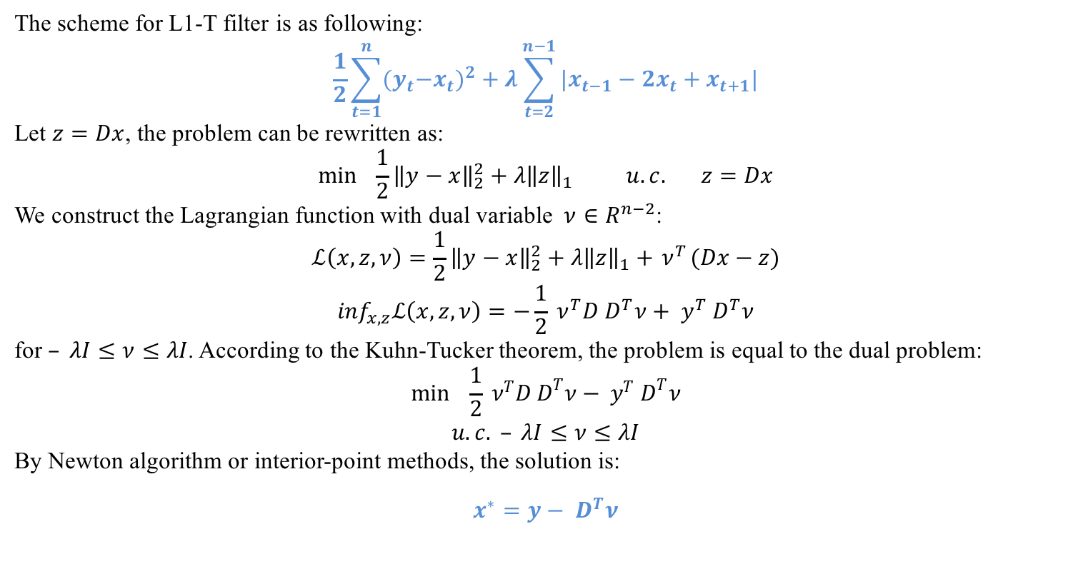
The L1-T Filter
The scheme for L1-T filter is as following:
$$\frac{1}{2}\sum_{t=1}^{n}{{{(y}_{t}−x_{t})}^{2}}+λ\sum_{t=2}^{n−1}{|x_{t−1}−2x_{t}+x_{t+1}|}$$
Let $z=Dx$, the problem can be rewritten as:
$$\min{ }\frac{1}{2}{\left\|y−x\right\|}_{2}^{2}+λ{\left\|z\right\|}_{1} u.c. z=Dx$$
We construct the Lagrangian function with dual variable $ν∈R^{n−2}$:
$$ℒ\left(x,z,ν\right)=\frac{1}{2}{\left\|y−x\right\|}_{2}^{2}+λ{\left\|z\right\|}_{1}+{ ν}^{T}(Dx−z)$$
$$\inf_{x,z}ℒ\left(x,z,ν\right)=−\frac{1}{2}{ ν}^{T}D{ D}^{T}ν+{ y}^{T}{ D}^{T}ν$$
for $– λI≤ν≤λI$. According to the Kuhn-Tucker theorem, the problem is equal to the dual problem:
$$\min{ }\frac{1}{2}{ ν}^{T}D{ D}^{T}ν−{ y}^{T}{ D}^{T}ν$$
$$u.c. – λI≤ν≤λI$$
By Newton algorithm or interior-point methods, the solution is:
$$x^{∗}=y−{ D}^{T}ν$$

Slide 6
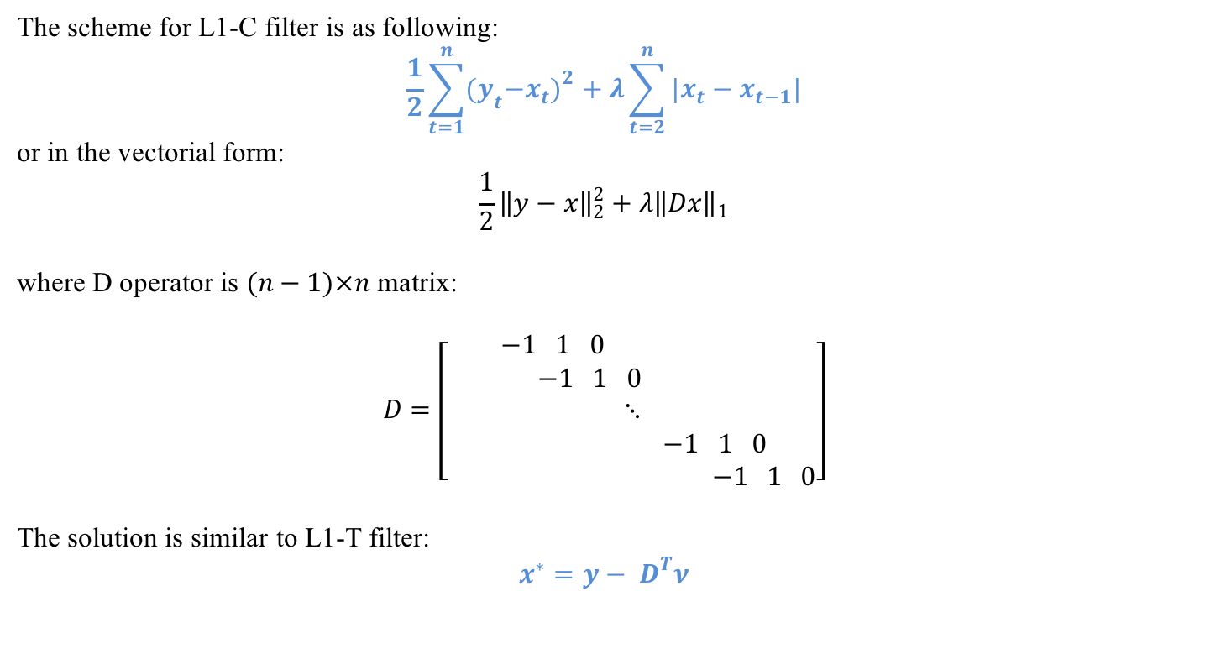
The L1-C Filter
The scheme for L1-C filter is as following:
$$\frac{1}{2}\sum_{t=1}^{n}{{{(y}_{t}−x_{t})}^{2}}+λ\sum_{t=2}^{n}{|x_{t}−x_{t−1}|}$$
or in the vectorial form:
$$\frac{1}{2}{\left\|y−x\right\|}_{2}^{2}+λ{\left\|Dx\right\|}_{1}$$
where D operator is $(n−1)×n$ matrix:
$$D=\left[\begin{aligned}−1 1 0 \\ −1 1 0 \\ ⋱ \\ −1 1 0 \\ −1 1 0\end{aligned}\right]$$
The solution is similar to L1-T filter:
$$x^{∗}=y−{ D}^{T}ν$$

Slide 7
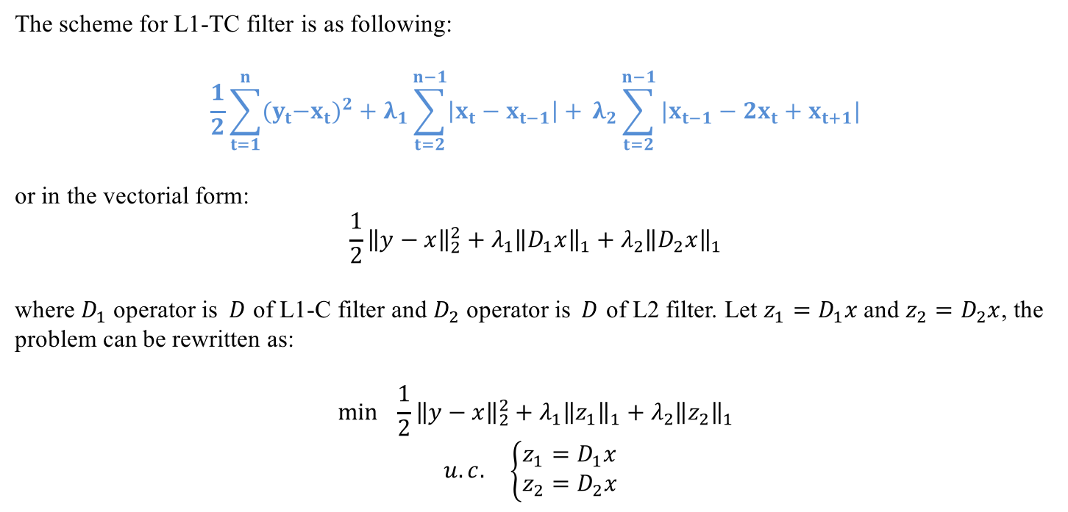
The L1-TC Filter
The scheme for L1-TC filter is as following:
$$\frac{1}{2}\sum_{t=1}^{n}{{{(y}_{t}−x_{t})}^{2}}+λ_{1}\sum_{t=2}^{n−1}{\left|x_{t}−x_{t−1}\right|+} λ_{2}\sum_{t=2}^{n−1}{|x_{t−1}−2x_{t}+x_{t+1}|}$$
or in the vectorial form:
$$\frac{1}{2}{\left\|y−x\right\|}_{2}^{2}+λ_{1}{\left\|D_{1}x\right\|}_{1}+λ_{2}{\left\|D_{2}x\right\|}_{1}$$
where $D_{1}$ operator is$D$ of L1-C filter and $D_{2}$ operator is$D$ of L2 filter. Let $z_{1}=D_{1}x$ and $z_{2}=D_{2}x$, the problem can be rewritten as:
$$\min{ }\frac{1}{2}{\left\|y−x\right\|}_{2}^{2}+λ_{1}{\left\|z_{1}\right\|}_{1}+λ_{2}{\left\|z_{2}\right\|}_{1}$$
$$u.c. \left\{\begin{aligned}z_{1}=D_{1}x \\ z_{2}=D_{2}x\end{aligned}\right.$$

Slide 8
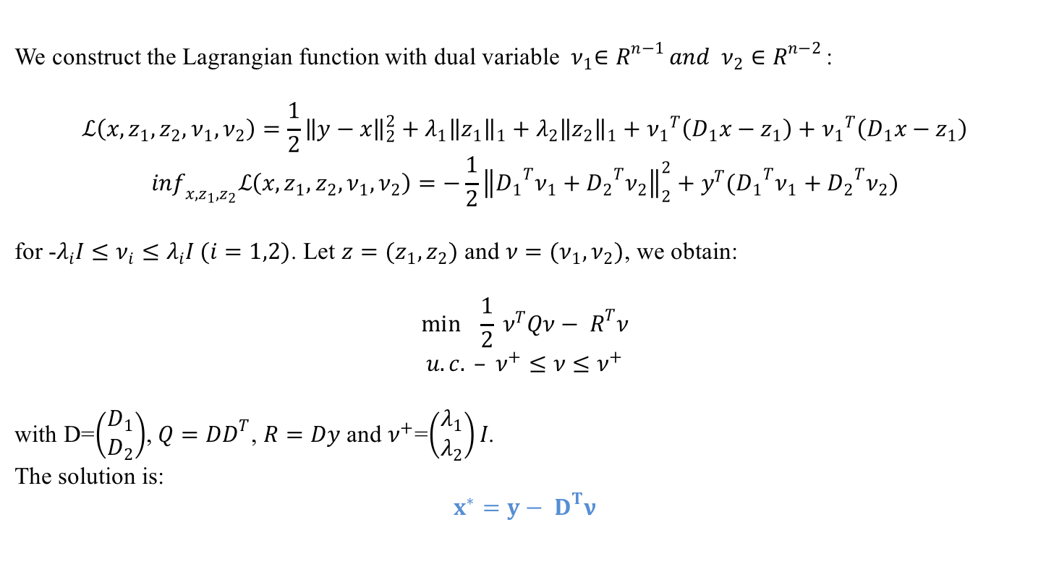
The L1-TC Filter
We construct the Lagrangian function with dual variable ${ ν}_{1}∈R^{n−1 }and { ν}_{2}∈R^{n−2 }$:
$$ℒ\left(x,z_{1},z_{2},ν_{1},ν_{2}\right)=\frac{1}{2}{\left\|y−x\right\|}_{2}^{2}+λ_{1}{\left\|z_{1}\right\|}_{1}+λ_{2}{\left\|z_{2}\right\|}_{1}+{ν_{1}}^{T}\left(D_{1}x−z_{1}\right)+{ν_{1}}^{T}\left(D_{1}x−z_{1}\right)$$
$$\inf_{x,z_{1},z_{2}}ℒ\left(x,z_{1},z_{2},ν_{1},ν_{2}\right)=−\frac{1}{2}{\left\|{D_{1}}^{T}ν_{1}+{D_{2}}^{T}ν_{2}\right\|}_{2}^{2}+y^{T}({D_{1}}^{T}ν_{1}+{D_{2}}^{T}ν_{2})$$
for -$λ_{i}I≤ν_{i}≤λ_{i}I (i=1,2)$. Let $z=(z_{1},z_{2})$ and $ν=(ν_{1},ν_{2})$, we obtain:
$$\min{ }\frac{1}{2}{ ν}^{T}Qν−{ R}^{T}ν$$
$$u.c. – ν^{+}≤ν≤ν^{+}$$
with D=$\left(\begin{aligned}D_{1} \\ D_{2}\end{aligned}\right)$, $Q=DD^{T}$, $R=Dy$ and $ν^{+}$=$\left(\begin{aligned}λ_{1} \\ λ_{2}\end{aligned}\right)I$.
The solution is:
$$x^{∗}=y−{ D}^{T}ν$$

Slide 9
Quantitative Methods in Finance
2. Simulation and Filter Comparation
Model 1:
Based on Straight Trend Lines
Model 2:
Based on Step Trend Lines
Filter Performance: Compared with actual trend

Slide 10
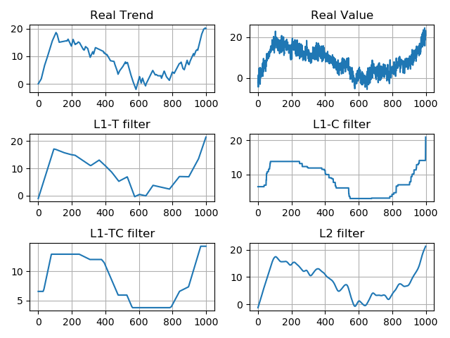
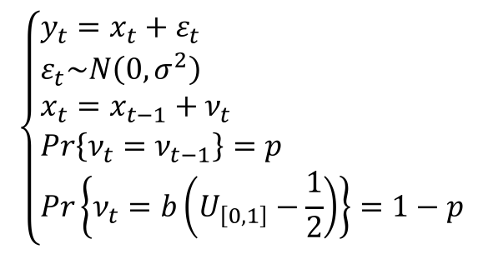
Model 1 & Filter Comparation
In Model 1, we construct a stochastic process which consist of data simulated by a set of straight trend lines with a white noise perturbation:
$$\left\{\begin{aligned}&y_{t}=x_{t}+ε_{t} \\ &ε_{t}\sim Ν\left(0,σ^{2}\right) \\ &x_{t}=x_{t−1}+ν_{t} \\ &Pr\left\{ν_{t}=ν_{t−1}\right\}=p \\ &Pr\left\{ν_{t}=b\left(U_{\left[0,1\right]}−\frac{1}{2}\right)\right\}=1−p\end{aligned}\right.$$
L1-T and L2 perform better than L1-C and L1-TC

Slide 11
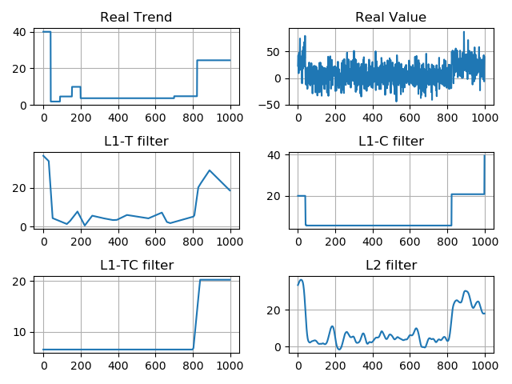
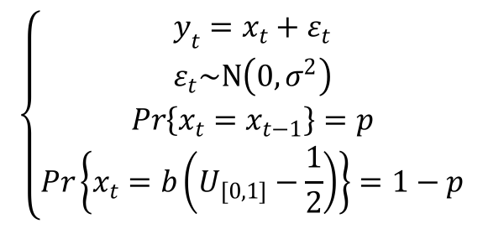
Model 2 & Filter Comparation
In Model 2, we construct a stochastic process which consist of data simulated by a set of step trend lines with a white noise perturbation:
$$\left\{\begin{aligned}y_{t}=x_{t}+ε_{t} \\ ε_{t}\sim Ν\left(0,σ^{2}\right) \\ Pr\left\{x_{t}=x_{t−1}\right\}=p \\ Pr\left\{x_{t}=b\left(U_{[0,1]}−\frac{1}{2}\right)\right\}=1−p\end{aligned}\right.$$
L1-C and L1-TC perform better than L1-T and L2

Slide 12


Quantitative Methods in Finance
3. Cross Validation
Cross Validation Method
Interval of Optimal $λ$
Filtered Trend with Optimal $λ$

Slide 13
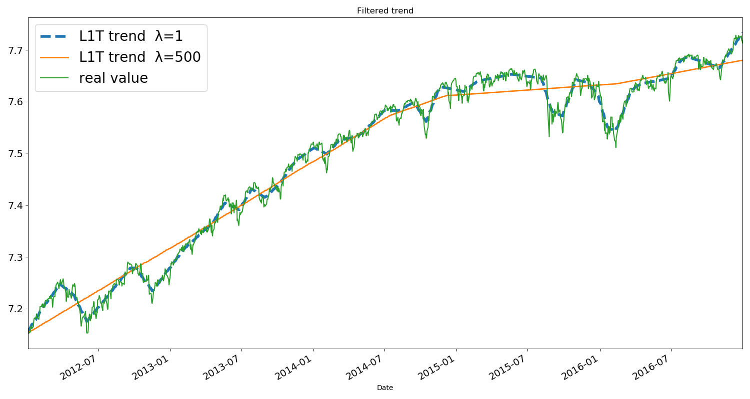
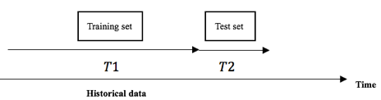
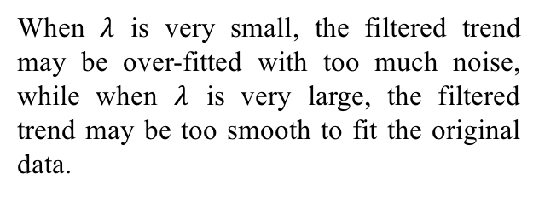
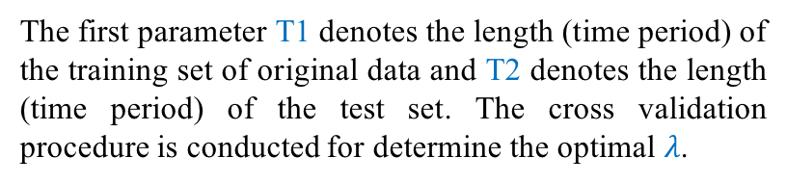
Cross Validation
When $λ$ is very small, the filtered trend may be over-fitted with too much noise, while when $λ$ is very large, the filtered trend may be too smooth to fit the original data.
The first parameter T1 denotes the length (time period) of the training set of original data and T2 denotes the length (time period) of the test set. The cross validation procedure is conducted for determine the optimal $λ$.
L1-T Filtered Trend for S&P 500 from 2012 to 2016
Cross Validation Procedure

Slide 14
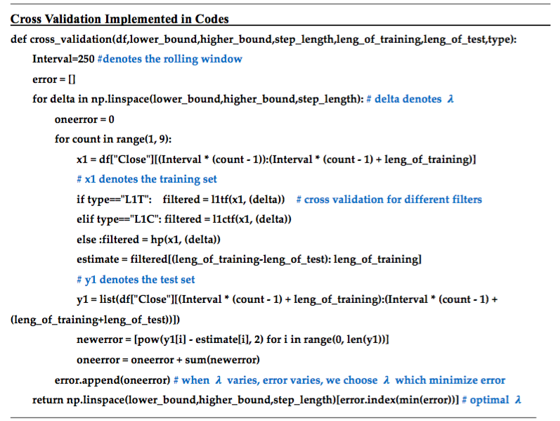
Cross Validation

Slide 15
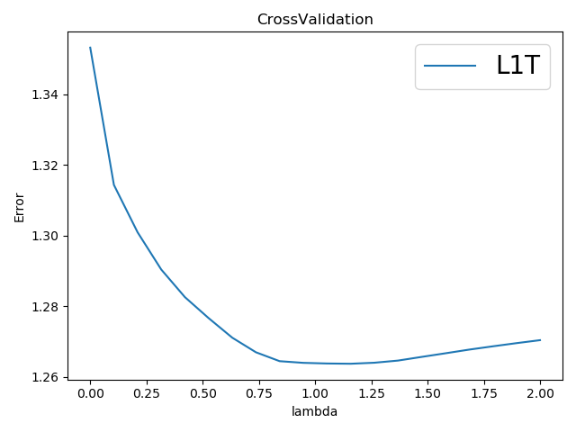
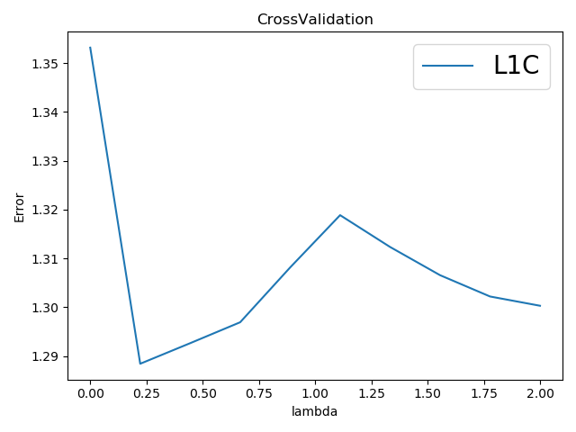
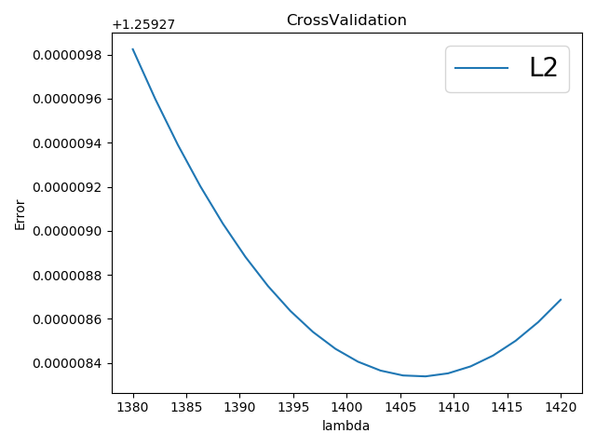
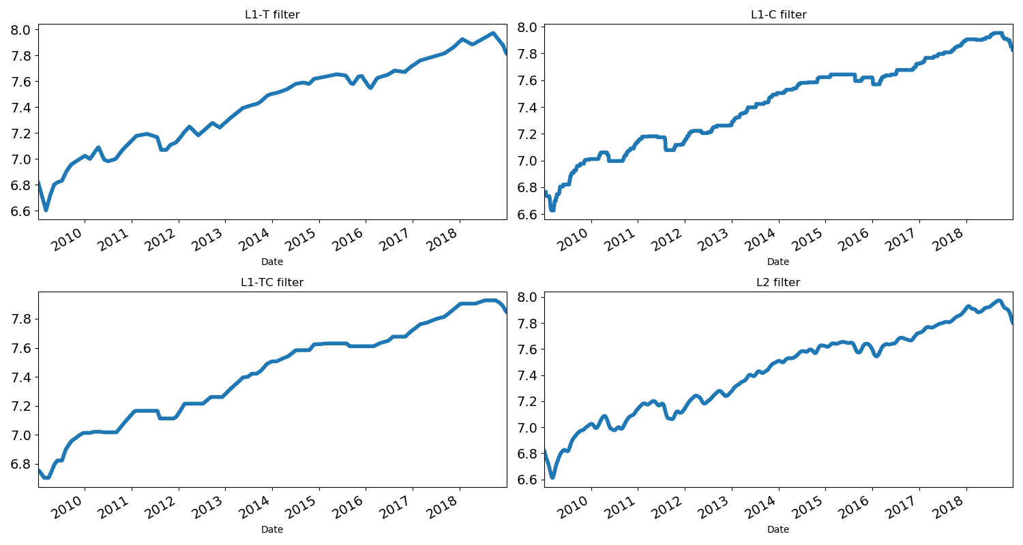



Cross Validation
$λ$ versus error for filter L1-T
$λ$ versus error for filter L1-C
$λ$ versus error for filter L2

Slide 16
Quantitative Methods in Finance
4. Trend Detection and Distribution
Trend Detection
Implementation
Distribution of Return

Slide 17
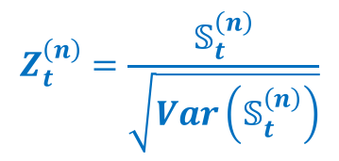
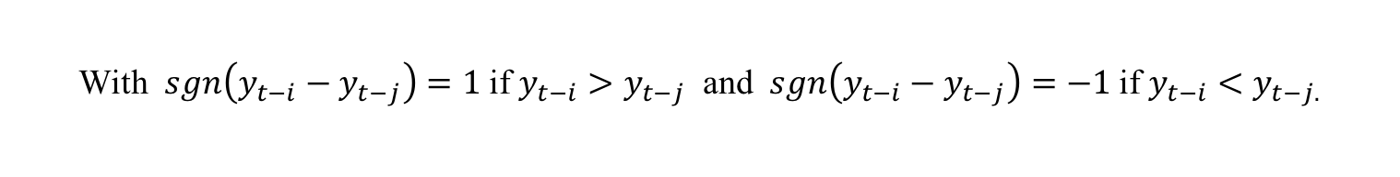
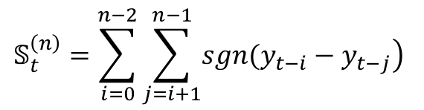
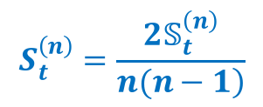
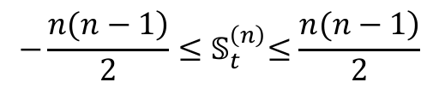

Trend Detection
$$𝕊_{t}^{\left(n\right)}=\sum_{i=0}^{n−2}{\sum_{j=i+1}^{n−1}{\left.sgn(y_{t−i}−y_{t−j}\right)}}$$
With $sgn\left(y_{t−i}−y_{t−j}\right)=1$ if $y_{t−i}>y_{t−j}$ and$sgn\left(y_{t−i}−y_{t−j}\right)=−1$ if $y_{t−i}<y_{t−j.}$
It can be shown that:
$${−\frac{\left.n(n−1\right)}{2}≤𝕊}_{t}^{\left(n\right)}≤\frac{\left.n(n−1\right)}{2}$$
$$S_{t}^{\left(n\right)}=\frac{{2𝕊}_{t}^{\left(n\right)}}{\left.n(n−1\right)}$$
The normalized score should be:
$$Z_{t}^{\left(n\right)}=\frac{𝕊_{t}^{\left(n\right)}}{\sqrt{Var\left(𝕊_{t}^{\left(n\right)}\right)}}$$
$Z_{t}^{\left(n\right)}\overset{→}{n→∞}N(0,1$)

Slide 18
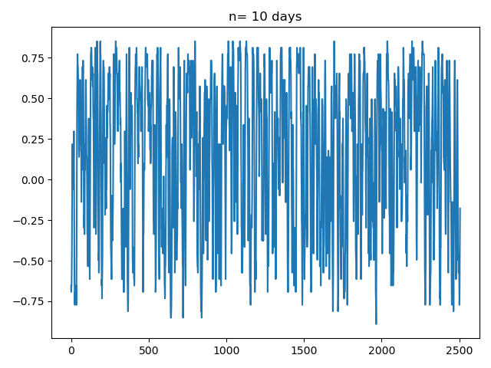
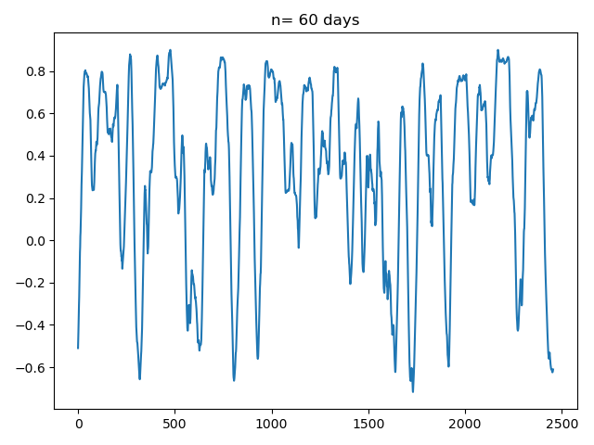
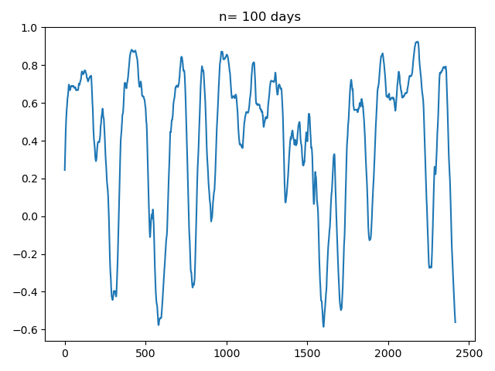
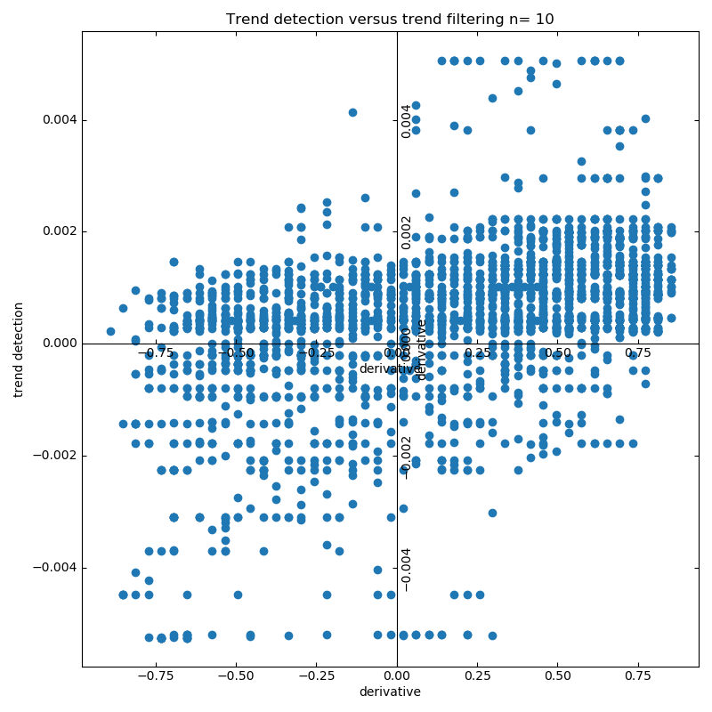
Trend Detection
Trend Detection (n=10 days)
Trend Detection (n=60 days)
Trend Detection (n=100 days)
Frequencies of Rejecting the Null Hypothesis with Confidence Level
Trend Detection Versus L1-T Filter (n=10)
Confidence Level | 90% | 95% | 99%
n=10 days | 59.98% | 49.92% | 38.39%
n=60 days | 88.12% | 85.33% | 82.07%
n=100 days | 87.88% | 85.93% | 84.49%

Slide 19
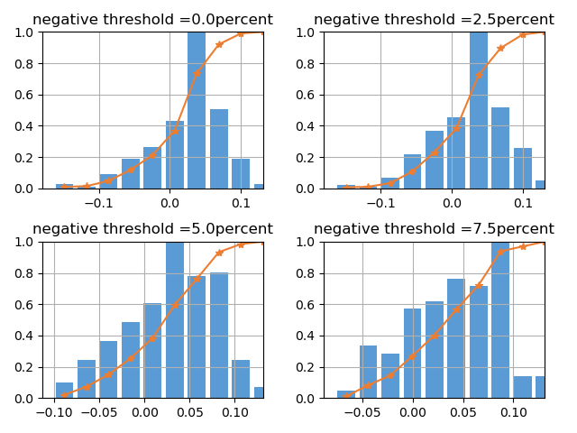
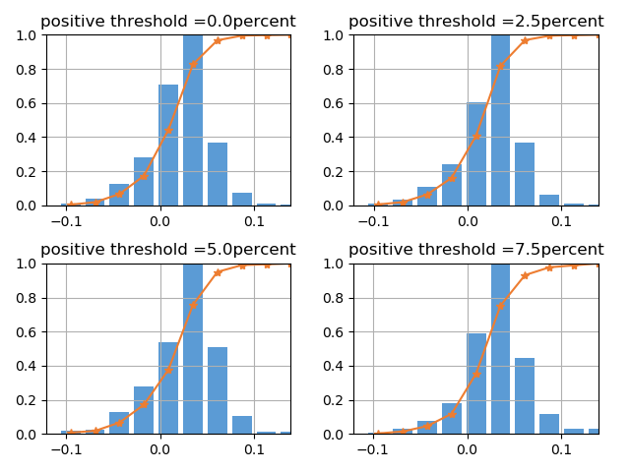
Distribution of Return

Slide 20
Quantitative Methods in Finance
5. Momentum Strategies and Backtest
Backtest Assumptions
Backtest
Procedures
Momentum Strategy
Results

Slide 21
Backtest Assumptions
We first hold 100000 cash and we invest these cash in the underlying we want.
There is no vital financial crisis within the back test years.
The underlying market is the only market that we may invest.
We hold the stock for a constant period.
Every time we invest all the money in each trade.
There is no transaction cost.
When we short we only short the amount of our cash/price of underlying

Slide 22
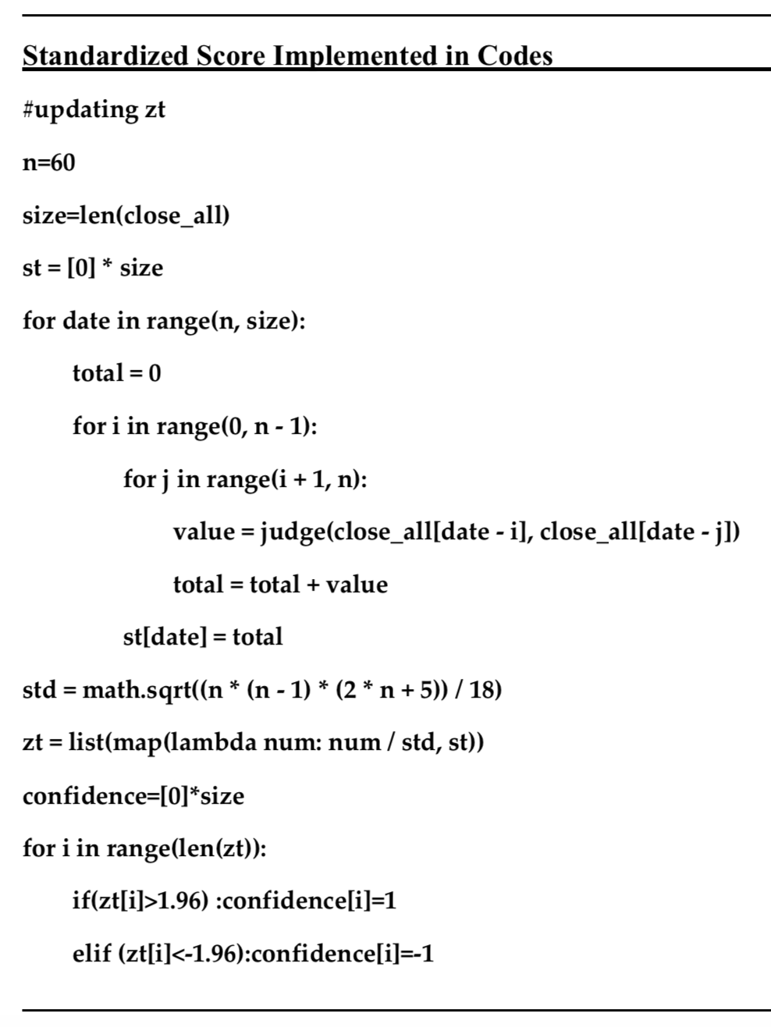
Backtest
Filtered = l1tf(start, lambda)
Average_filtered_derivative with year 1
Filtered = l1tf(newstart, lambda) loop to update
Average_filtered_derivative with year 2
Updating Zt score for each point
Average_filtered_derivative
Action List
Best Selling Period for year 2 & Biggest Revenue

Slide 23
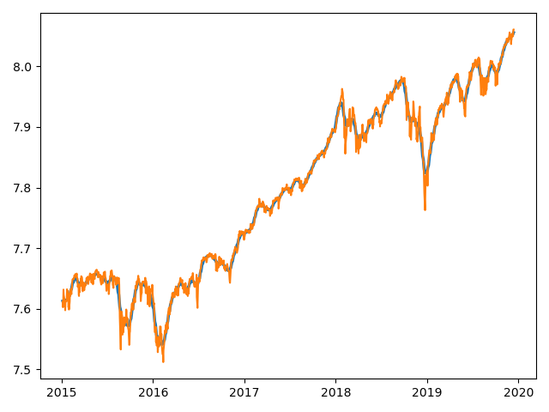
Trend Filtering

Slide 24
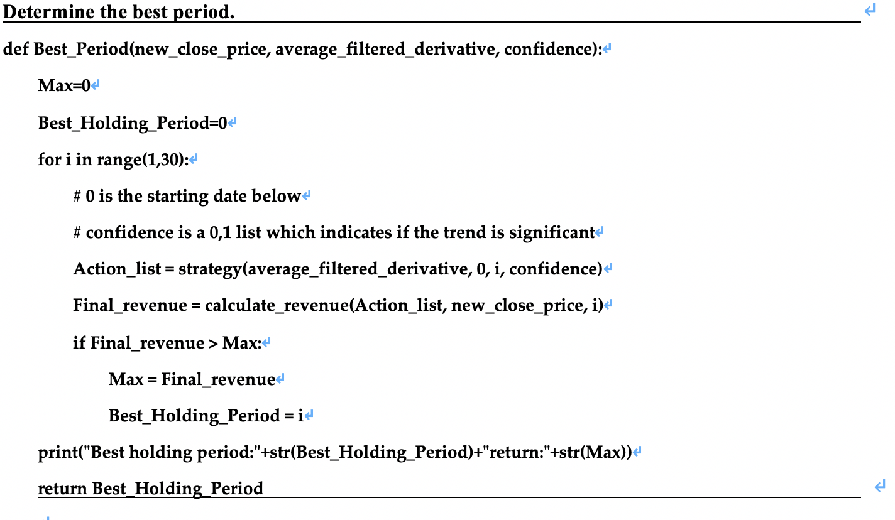

Slide 25
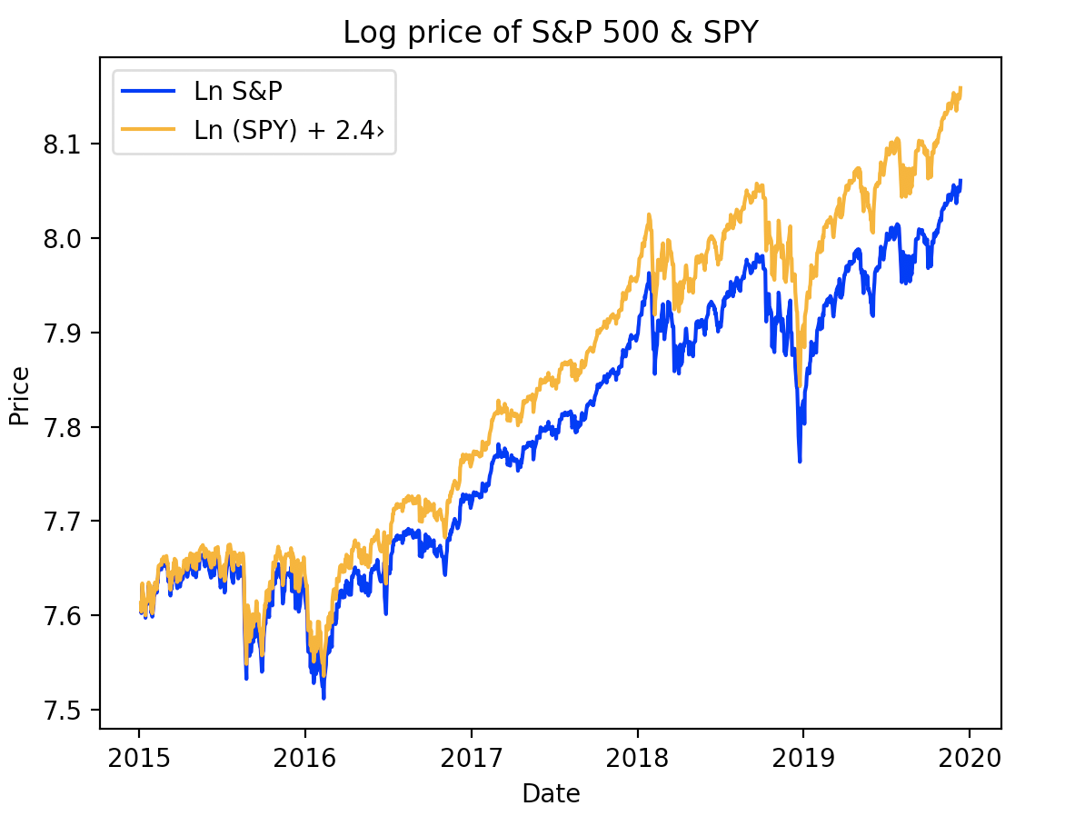
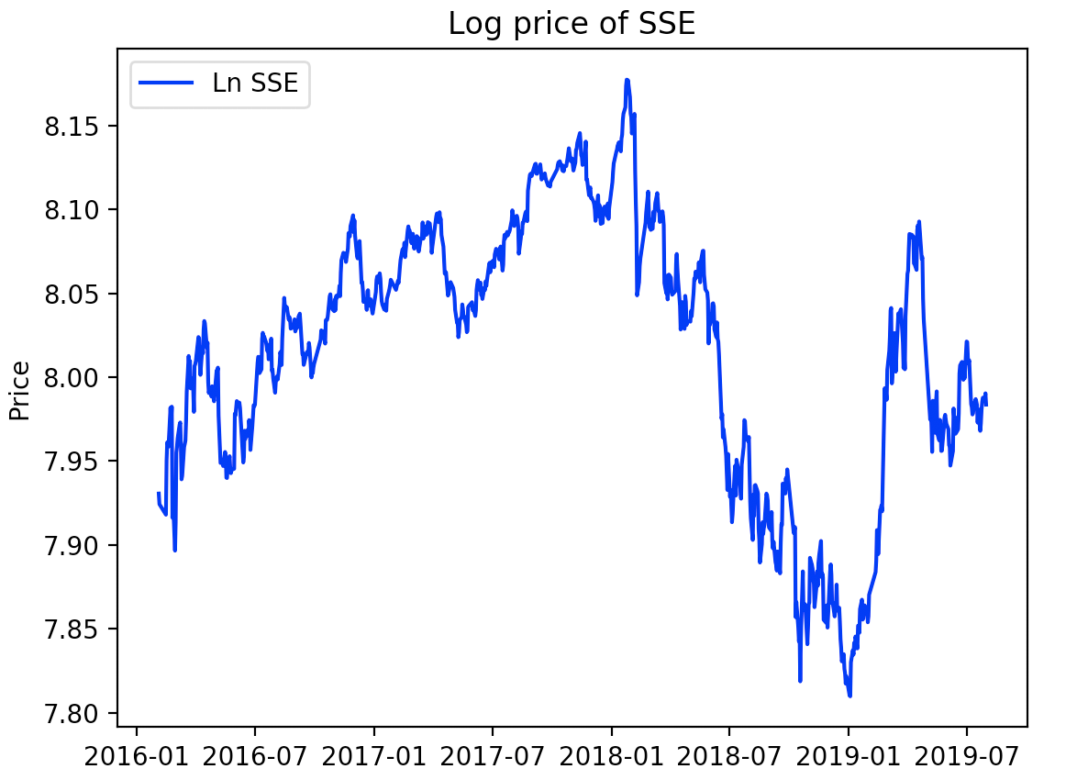
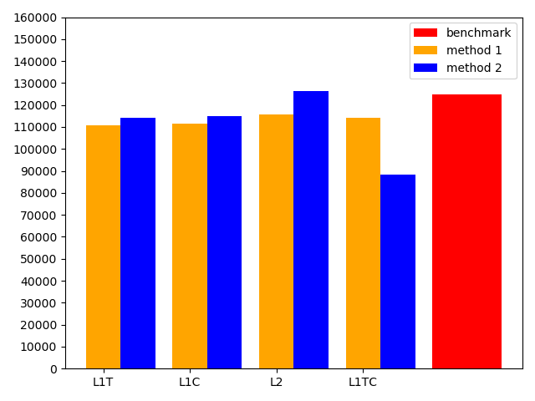
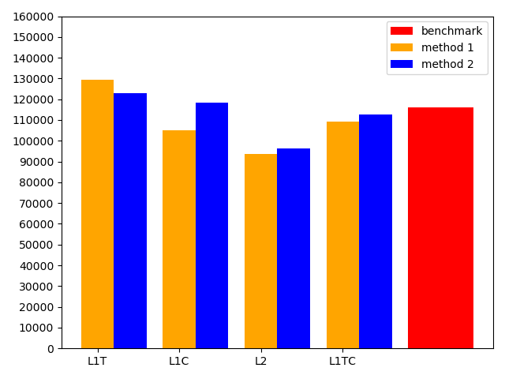
Results
S&P 500
SSE(00001.SS)

Slide 26
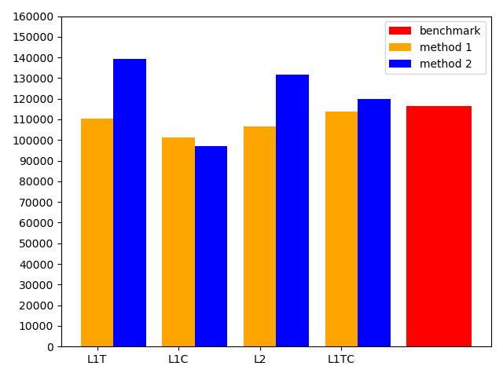
Revenue on Commodity

Slide 27
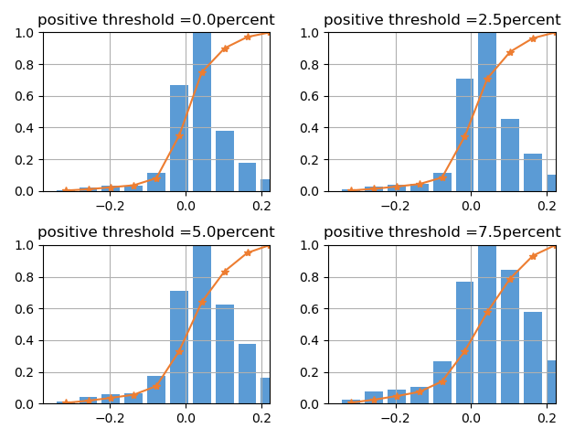
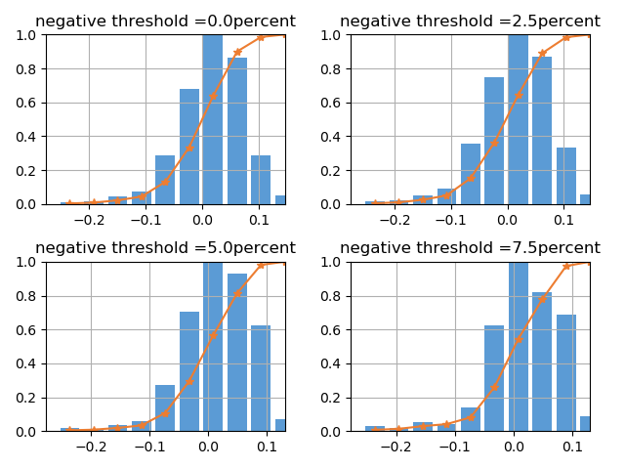
Momentum detection

Slide 28

Quantitative Methods in Finance
6. Challenges and Improvements
Wavelet Filter
Denoising Process
Optimal $λ$ Interval

Slide 29
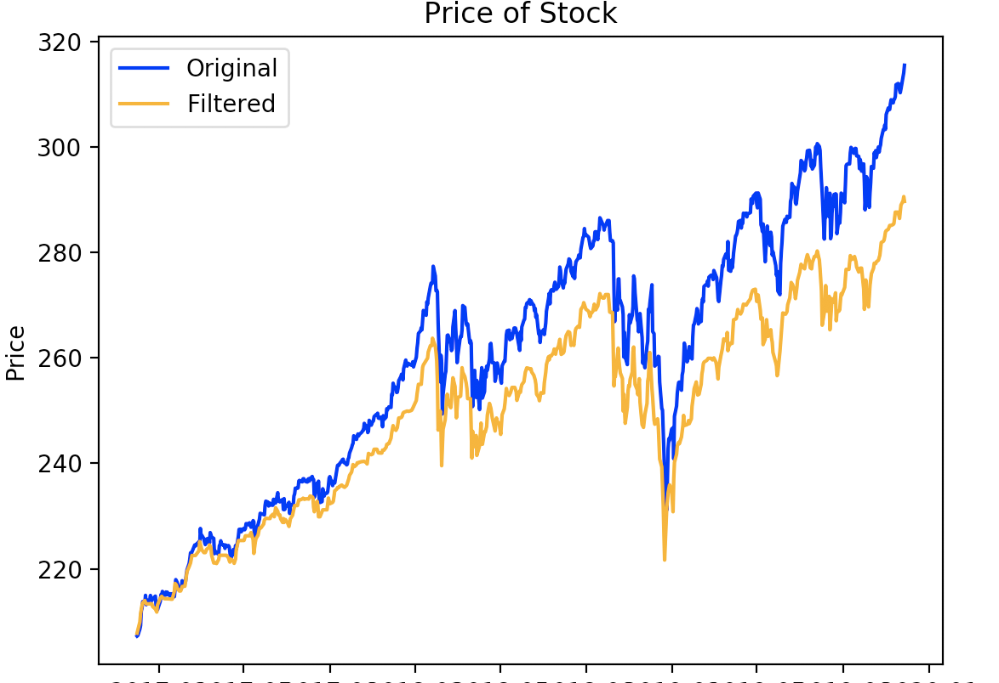

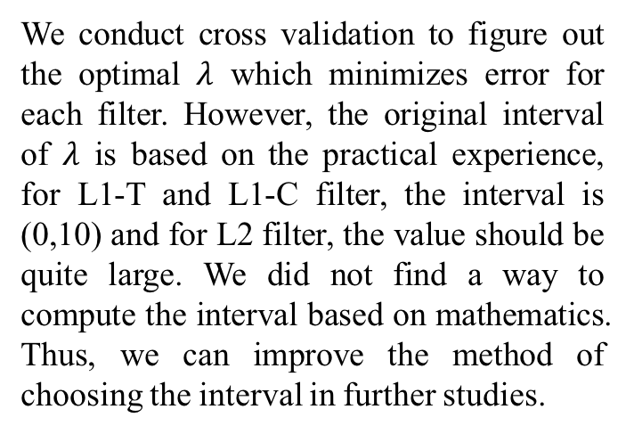
Challenges
Wavelet Filter and Denoising
Optimal $λ$ Interval
We conduct cross validation to figure out the optimal $λ$ which minimizes error for each filter. However, the original interval of $λ$ is based on the practical experience, for L1-T and L1-C filter, the interval is (0,10) and for L2 filter, the value should be quite large. We did not find a way to compute the interval based on mathematics. Thus, we can improve the method of choosing the interval in further studies.

Slide 30
References
[1] Benjamin Bruder, Tung-Lam Dao, Jean-Charles Richard, Thierry Roncalli (2011), Trend Filtering Methods for Momentum Strategies, University of Evry.
[2] Beveridge S. and Nelson C.R. (1981), A New Approach to the Decomposition of Economic Time Series into Permanent and Transitory Components with Particular Attention to Measurement of the Business Cycle, Journal of Monetary Economics.
[3] Daubechies I., Defrise M. and De Mol C. (2004), An Iterative Thresholding Al- gorithm for Linear Inverse Problems with a Sparsity Constraint, Communications on Pure and Applied Mathematics.
[4] Hodrick R.J. and Prescott E.C. (1997), Postwar U.S. Business Cycles: An Empirical Investigation, Journal of Money, Credit and Banking.
[5] Kalaba R. and Tesfatsion L. (1989), Time-varying Linear Regression via Flexible Least Squares, Computers & Mathematics with Applications.
[6] Kim S-J., Koh K., Boyd S. and Gorinevsky D. (2009), L1 Trend Filtering, SIAM Review.
[7] Tibshirani R. (1996), Regression Shrinkage and Selection via the Lasso, Journal of the Royal Statistical Society B.
[8] Tung-Lam Dao (2014), Momentum Strategies with L1 Filter, Journal of Investment Strategies.

Slide 31
Quantitative Methods in Finance
Thank you for listening !

